Slide 1

Grammar of Graphics
Notes:
we’ve talked a lot about how d3 enables a mental model for data visualization
this is true for other languages as well

Slide 2
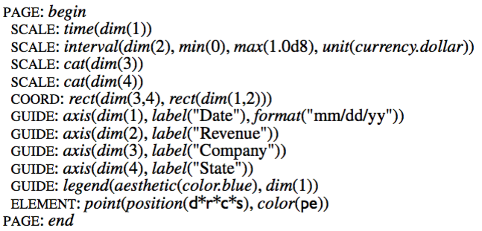
Graphics Production Language (GPL)
Notes:
GPL, developed at US BLS 1994

Slide 3
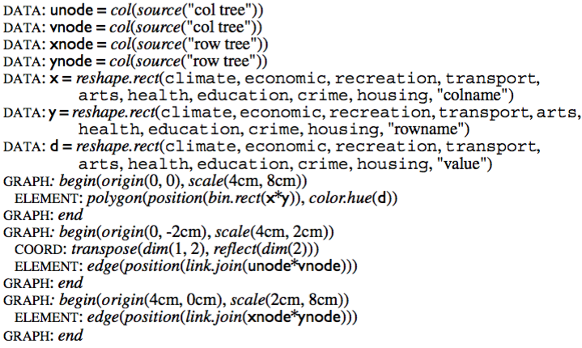
Graphics Production Language (GPL)
Notes:
GPL, developed at US BLS 1994

Slide 4
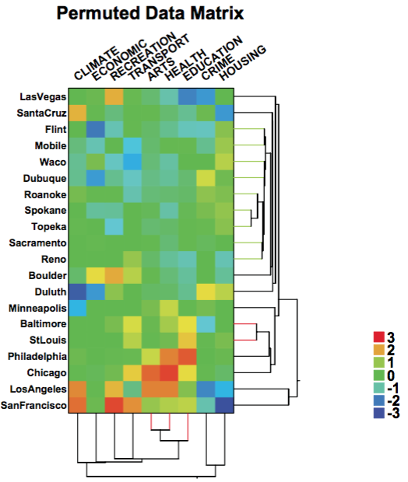
Graphics Production Language (GPL)
Notes:
GPL, developed at US BLS 1994

Slide 5
Visualization Markup Language (VizML)
XML-based (like SVG)
Notes:
SPSS, old

Slide 6
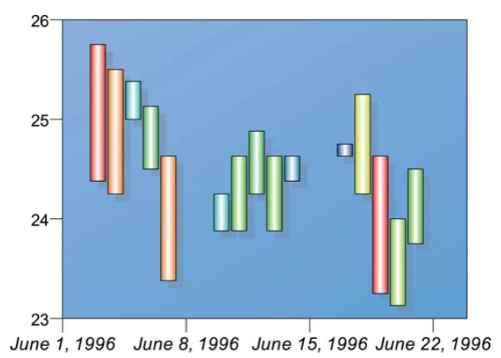
Visualization Markup Language (VizML)
XML-based (like SVG)
Notes:
SPSS, old

Slide 7
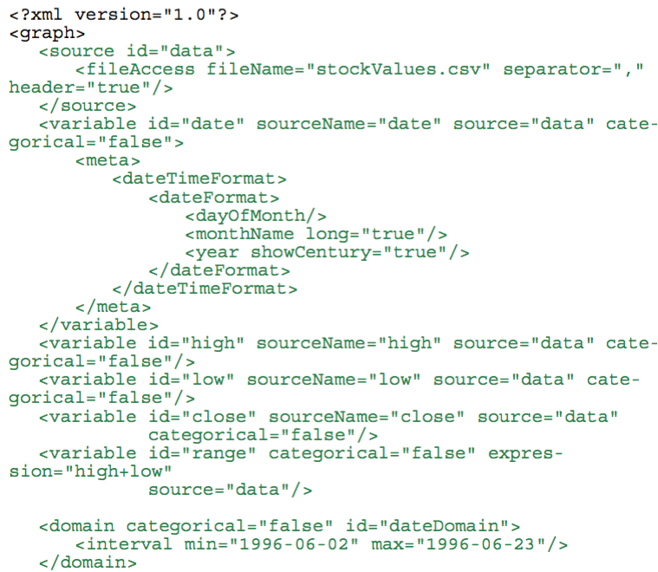
Visualization Markup Language (VizML)
Notes:
part 1 of 3, this is the data part

Slide 8
VizQL
Proprietary visualization grammar underlying Tableau
Evolved from Polaris system at Stanford (extends pivot tables)
Notes:
http://www.graphics.stanford.edu/projects/polaris/

Slide 9
Vega and Vega-Lite
Notes:
underlies polestar, voyager, lyra
https://medium.com/hci-design-at-uw/introducing-vega-lite-438f9215f09e#.olj5i9n53

Slide 10
Vega-Lite

Slide 11
Vega-Lite

Slide 12


